Slide 1

CSE 470 - Software Engineering Overview
BRAC University

Slide 2
Course Content
Software Engineering Overview
Software Process Models
Software Architecture
Software Repository
Software Design Pattern
Software Testing
Software Cost Estimation

Slide 3
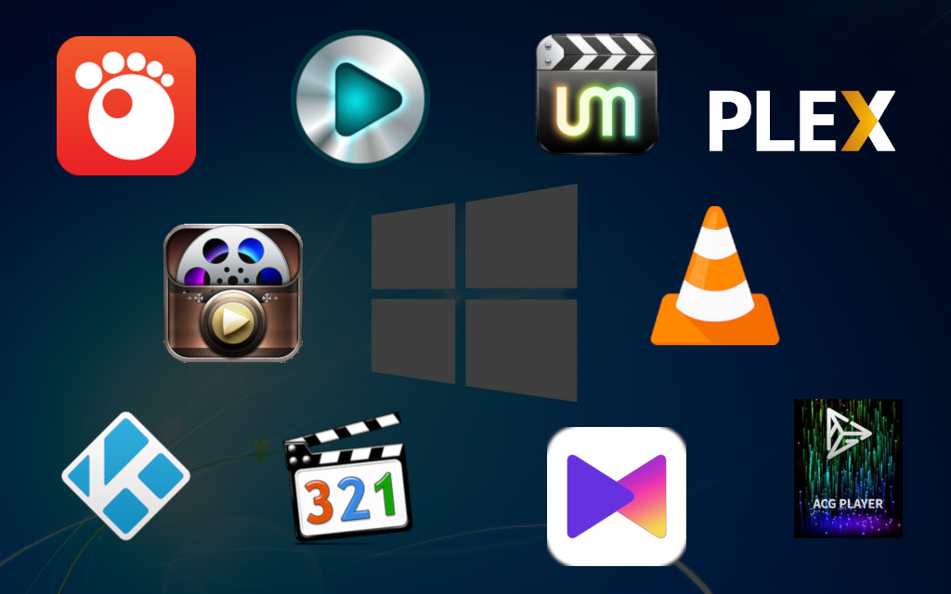
What is Software
Actually you are using Software now !!!!

Slide 4
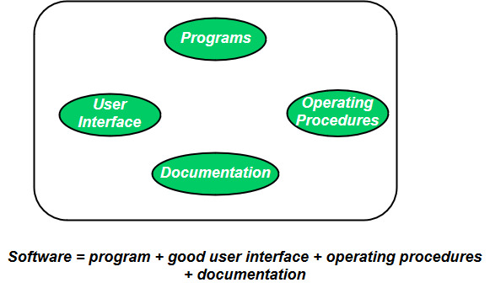
What is Software
Formal Definition: Software is: (1) instructions (computer programs) that when executed provide desired features, function, and performance
(2)data structures that enable the programs to adequately manipulate information, and
(3) documented descriptive information in both hard copy and virtual forms that describes the operation and use of the programs.

Slide 5
What is Engineering
Engineering on the other hand is all about developing solutions, using systematic, scientific and well defined principles and methods.

Slide 6

Example Problem
Solve the Engineering problem using Software

Slide 7

Define Software Engineering
Formal Definition: Software Engineering is the application of a systematic, disciplined, quantifiable approach to the development, operation, and maintenance of software; that is, the application of engineering to software.

Slide 8
Summary
Software is the collection of program, data structures, operational programs, user interface and documentation.
Software engineering is the application of engineering principles in developing software.

